Slide 1

US SWE Salaries Analysis Project
Guochen Liao

Slide 2
DataViz Purpose
The project aims to analyze the economic landscape for software developers across states by examining their salaries and other financial metrics. It seeks to understand the financial advantages and disparities within the software developers compared to other careers.
The visualization facilitates job seekers to identify financially advantageous locations for software development careers.

Slide 3
Questions
How does the salary of SWEs compare across different states?
What is the percentage of salary for SWEs over other professions?
What is the percentage of rent over salary for SWEs compared with other professions?

Slide 4
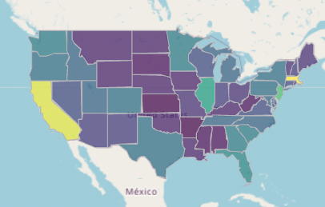
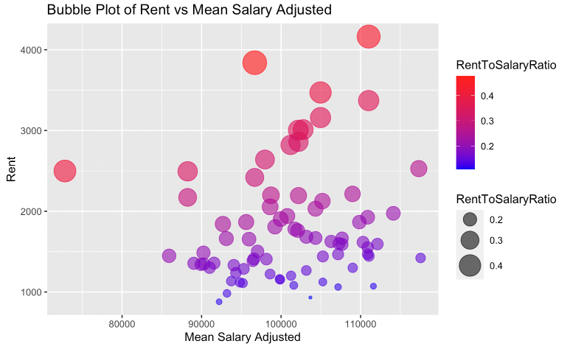
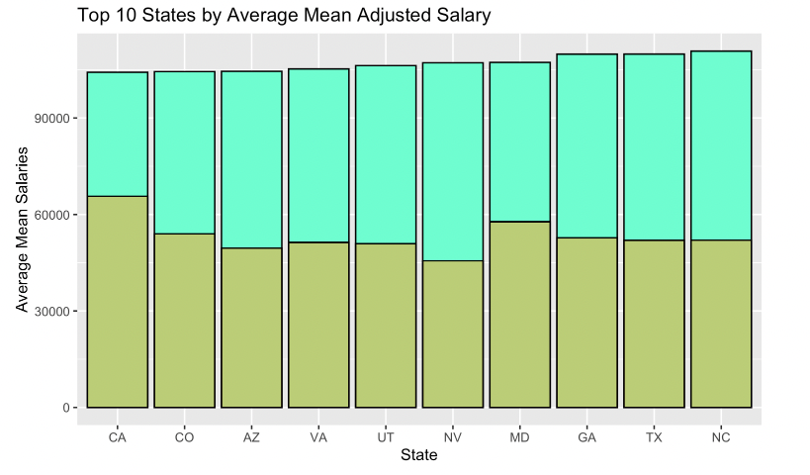
Insights From Data
The rent constitutes approximately 21.4% of the total salary for a SWE, contrasting with 39.5% for average salaries across all careers.
There is a notable discrepancy in the salary structures between software developers and other professions, highlighting financial advantages associated with a career in software development.

